Slide 1

Fun & Learning for Little Ones!
Welcome to a world where kids can explore, learn, and grow through engaging digital adventures!

Slide 2
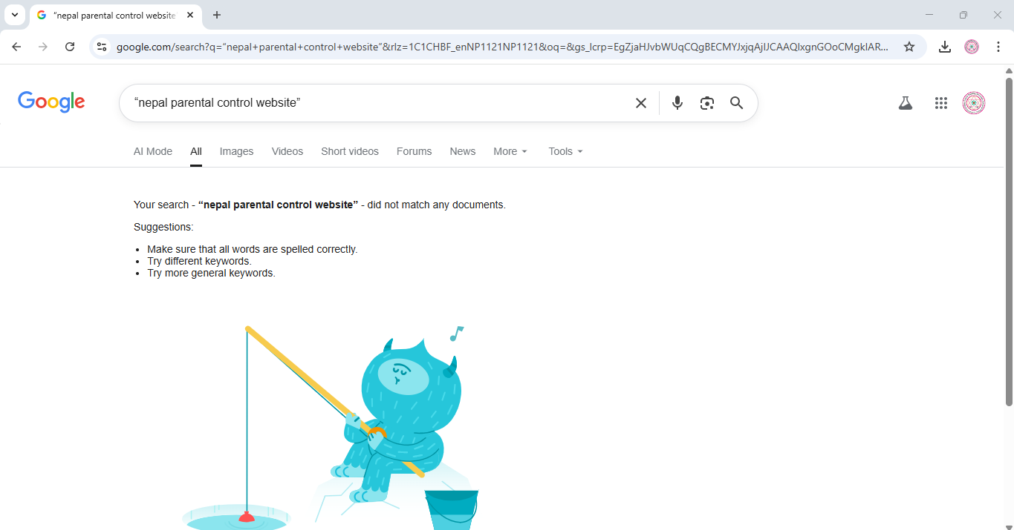
Brand-New Innovation In Nepal’s Tech History

Slide 3
Know Our sections
1. Kids Section : No login or Sign-in required. Safe and Secured. Serves only child appropriate content
2. Parents Section : Login or Sign-in required. Serves special functions, like blocking categories and determining time limit

Slide 4










Discover Our Child’s Magical World!
Music
Shows
Sing-along rhymes!
Cartoon adventures!
Stories
Moral tales & more!
Games
Simple, fun puzzles!
Learn
A-Z, 1-9, basics!

Slide 5
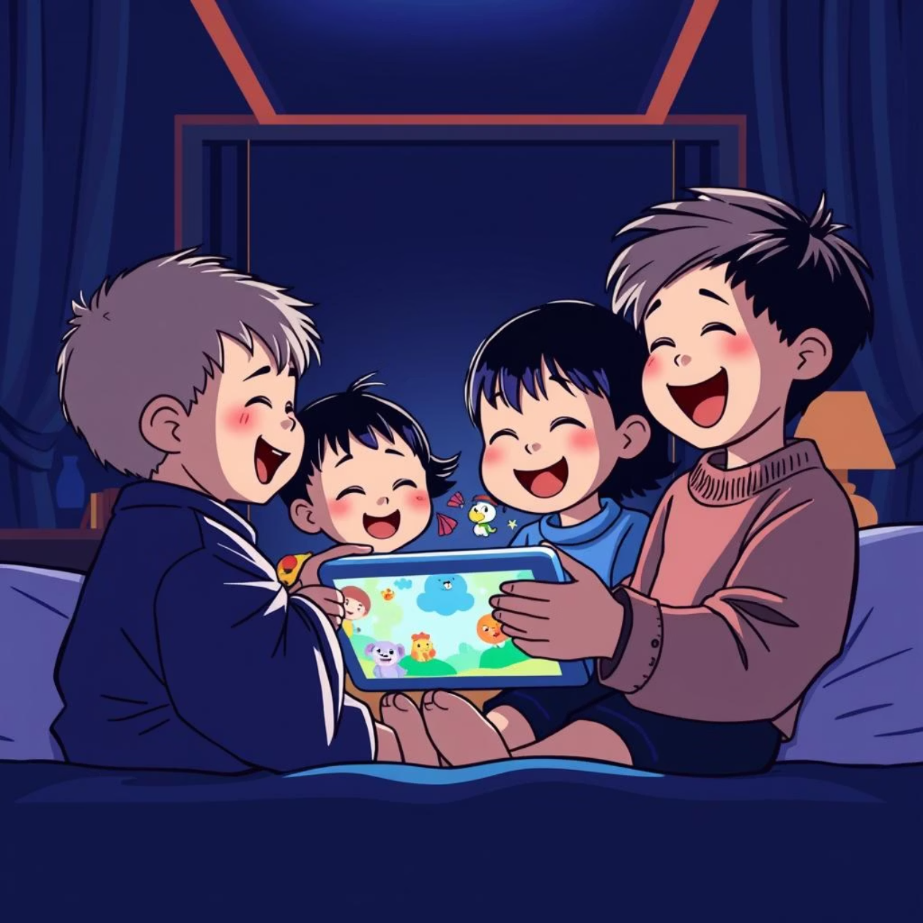
Shows: Cartoon Adventures Await!
From silly characters to exciting plots, our cartoon section sparks imagination and joy. Each show is carefully selected for age-appropriateness and positive messages.
Educational themes
Engaging storylines
Positive role models

Slide 6


Music & Stories: Rhythmic Rhymes & Moral Tales
Rhymes & Songs
Enchanting Stories
Tap your feet and sing along! Classic nursery rhymes and new favorites. Hear and start to sing your first song.
Discover timeless moral stories that teach valuable life lessons. Also explore numerous funny and enjoying stories

Slide 7
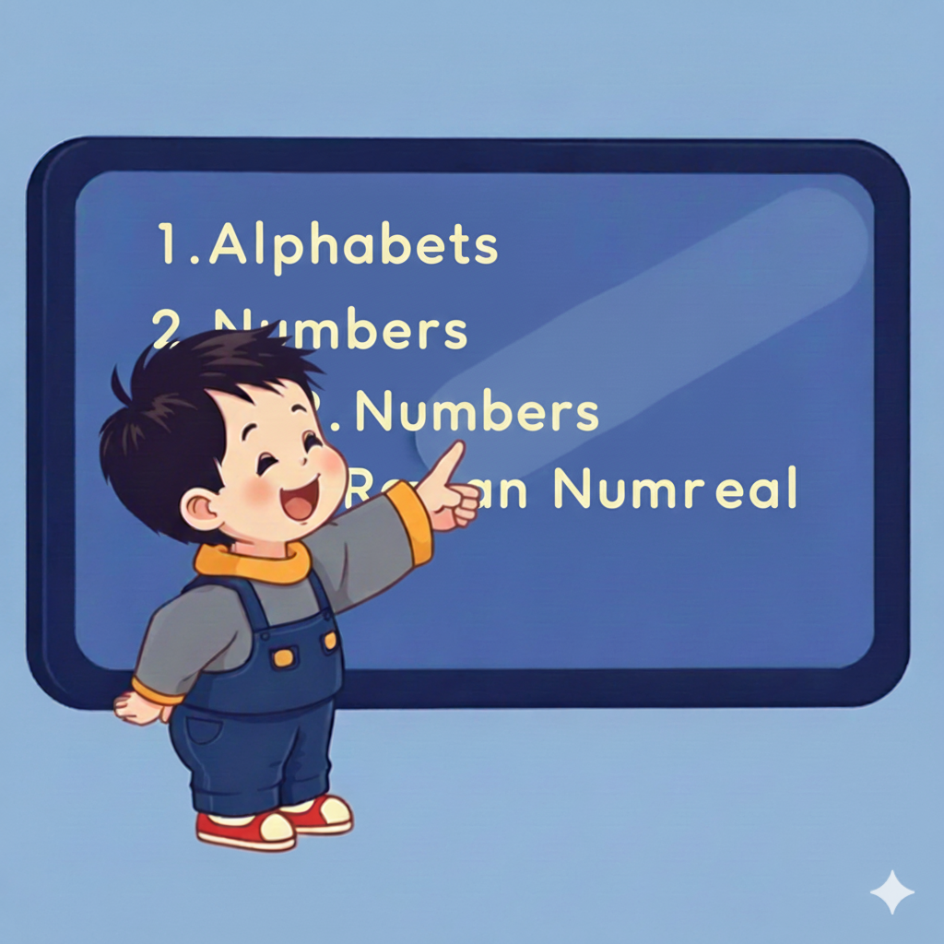
Learn & Play: Building Blocks of Knowledge
Learn the Basics
Alphabet A-Z
Numbers 1-9
Shapes & Colors
Early vocabulary
2. Fun Games
Simple scratch games designed to enhance problem-solving and creativity.

Slide 8

Parents' Corner: Your Peace of Mind 🛡️
We understand your concerns. Our dedicated parent section puts you in control. Access our parent’s Dashboard and make decision for your parents

Slide 9

Screen Time Management
40 minutes
1/6 section
Control Screen Time
View Watch History
Block Sections
Set daily limits.
See what they've watched.
Customize access.
Empowering you to create a balanced digital experience for your child.

Slide 10

Safe & Secure Environment
Time Limits: Set daily or weekly screen allowances.
Watch History: Keep track of viewed content.
Content Filters: Block specific sections or shows.
Personalized Settings: Tailor the app to your family's needs.
Rest assured, your child's digital journey is protected.

Slide 11



Easy Access & Setup
Simple Login
Customize Profiles
Family Friendly
Quick and easy access for parents.
Create personalized profiles for each child.
Designed for the whole family to enjoy.
Get started in just a few clicks!

Slide 12

That’s all in our Website
Give your child the gift of joyful learning with our web-based app. Fun, educational, and safe – all in one place!

